Slide 1

What could possibly go wrong?
Consider the “average” project:
Testing takes longer than planned – cannot resolve bugs
Vendor cannot deliver product on schedule
Critical engineer
Has accident (wipes out in ski jump)
Becomes a parent
Has a major surgery
Critical engineer leaves project/company
Change of ownership. Project on hold
Major downsizing
Dysfunctional staff
Blizzard and power failures

Slide 2
What is risk management?
‘A systematic way of looking at areas of risk and consciously determining how each should be treated. It is a management tool that aims at identifying sources of risk and uncertainty, determining their impact and developing appropriate management responses’.
ISO 31000 defined risk management as ‘coordinated activities to direct and control an organization with regard to risk’
Risk management in the engineering project management context is a systematic way of identifying, analysing and dealing with risks associated with a project in an aim to achieve the project objectives.

Slide 3
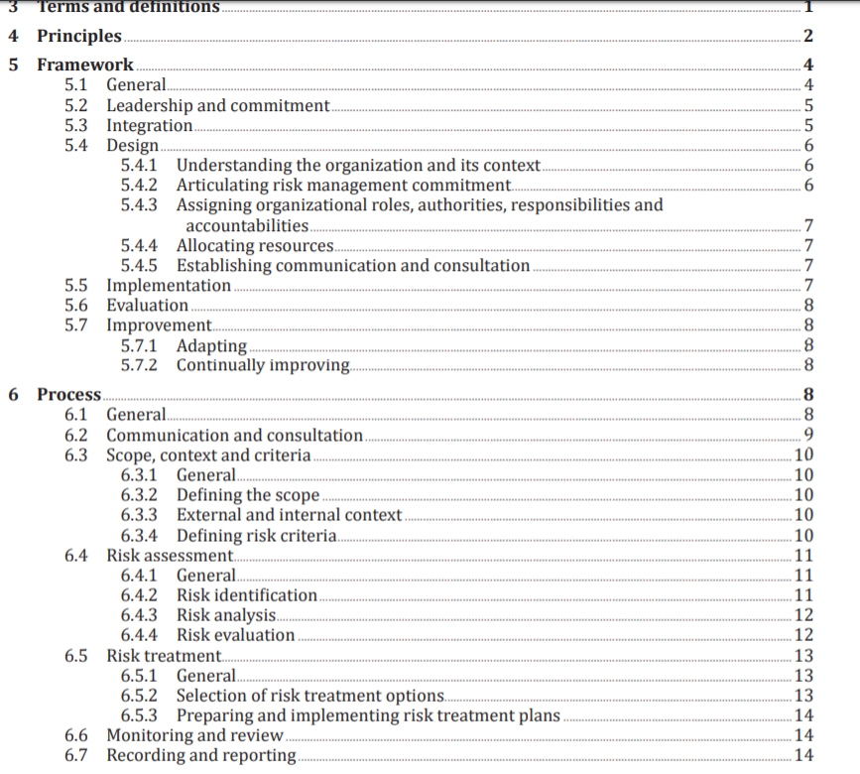
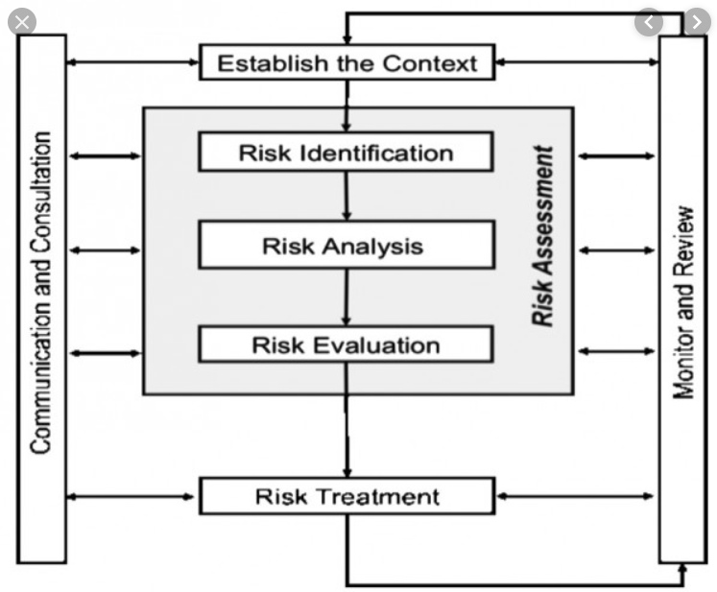
AS ISO 31000:2018 – Risk Management Guidelines

Slide 4
In order to understand and treat risk, you need to be clear about the context in which your organisation is operating.
Establish the Context
1. The organisational context (internal)
What are the aims and objectives of your organisation?
What is your organisation's core activity?
etc.
2. The Strategic Context (external)
What relationships does your organisation have and how important are these?
What laws, regulations, rules or standards apply to your organisation?
etc.
Notes:
Internal - looking at your organisation's aims, activities, structure, membership and methods of operation.
Who is involved with your organisation (stakeholders): Football club example, players, the coach, parents of players, other supporters, local businesses who sponsor the team, the council that provides oval and facilities.
What facilities do you have and/or use: Change rooms, oval, car park, etc.
Other questions: What is your organisation currently doing to manage risk? What type of insurances does your organisation have? What is the legal structure of your organisation, etc.?
Why understanding External? For example…
Nowadays, there is a greater public awareness of legal rights and an increasing tendency for people to take legal action if they feel they have been unfairly treated. You must review your legal obligations, Higher standards, Duty of care/Due diligence - FOR THE SAKE of litigious-ness

Slide 5
Risk Identification
Interview/Questionnaire
Brainstorming
Examination of experience
Audits or physical inspections
Judgemental – consensus, speculative/conjectural, intuitive
WBS
Cause and effect diagram
Delphi technique
History, failure analysis
Decision trees
SWOT (strengths, weaknesses, opportunities, and threats)
Hazard and operability studies
Historical records
Notes:
“The process of determining what, where, when, why and how something could happen.”

Slide 6
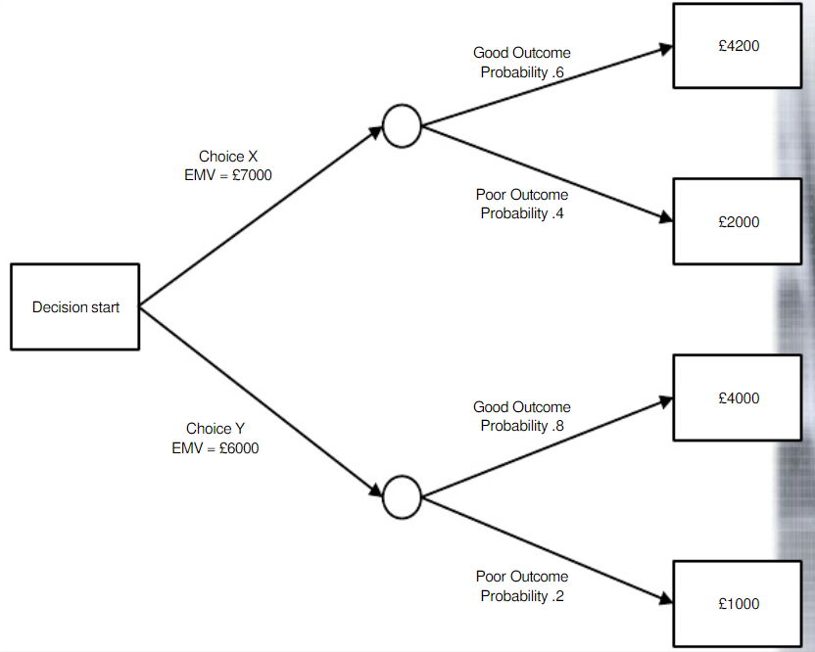

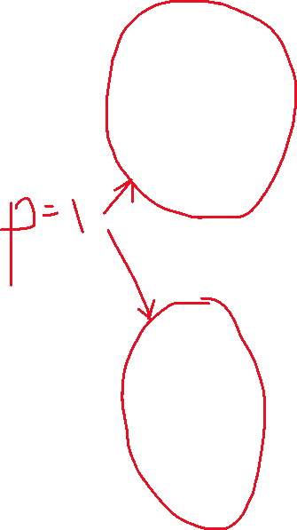
Decision-tree
0.6 x 4200 = 2520
Mutually-exclusive EVENTS
+
0.4 x 2000 =800
=
10320
9520
=
0.8 x 4000 = 3200
+
0.2 x 1000 = 200
Notes:
-7000 + 0.6 x 4200 =

Slide 7
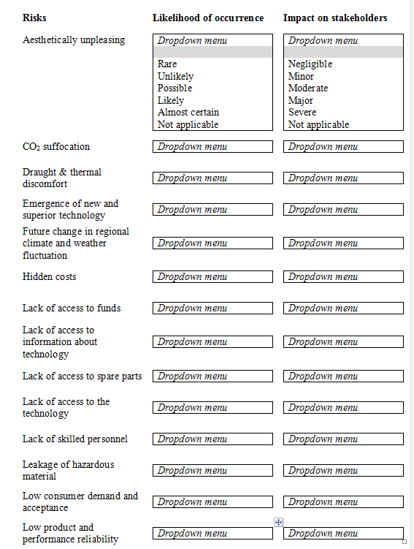
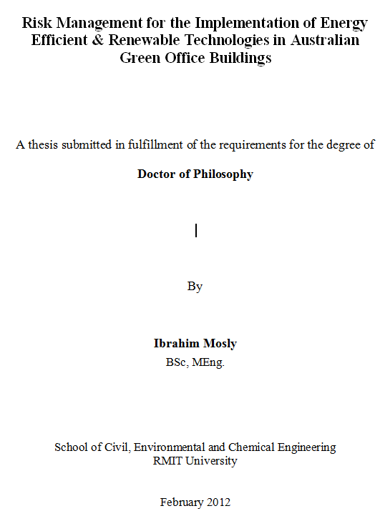
Questionnaire Survey / Interviews

Slide 8
Risk Analysis
Qualitative Risk Analysis: Likelihood and Consequence
Quantitative Risk Analysis: Sensitivity Analysis, Decision Tree, Monte Carlo Simulation, Analytical Hierarchy Process, Fuzzy Sets, etc.
Notes:
蒙特卡罗算法：采样越多，越近似最优解；
举个例子，假如筐里有100个苹果，让我每次闭眼拿1个，挑出最大的。于是我随机拿1个，再随机拿1个跟它比，留下大的，再随机拿1个……我每拿一次，留下的苹果都至少不比上次的小。拿的次数越多，挑出的苹果就越大，但我除非拿100次，否则无法肯定挑出了最大的。这个挑苹果的算法，就属于蒙特卡罗算法——尽量找好的，但不保证是最好的。

Slide 9
Likelihood & Consequence Analysis
Risk Impact = Likelihood X Consequence
Score | Likelihood descriptor | Description
1 | Rare/ Highly unlikely | The event may occur only in exceptional circumstances
2 | Unlikely | The event could occur at some time
3 | Moderate/ Possible | The event should occur at some time
4 | Likely | The event will probably occur in most circumstances
5 | Almost certain、Highly probable | The event is expected to occur in most circumstances
Score | Impact | Description
1 | Negligible/ Insignificant | Negligible impact upon objectives
2 | Minor | Minor effects that are easily remedied
3 | Moderate | Some objectives affected
4 | Major | Some important objectives cannot be achieved
5 | Severe/ Catastrophic | Most objectives cannot be achieved

Slide 10
Likelihood & Consequence Matrix
 | Negligible 1 | Minor 2 | Moderate 3 | Major 4 | Severe 5
Rare 1 | Low | Low | Medium | Medium | High
Unlikely 2 | Low | Low | Medium | Medium | High
Moderate 3 | Low | Medium | High | High | High
Likely 4 | Medium | Medium | High | High | Very High
Almost Certain 5 | Medium | High | High | Very High | Very High
Consequence
Likelihood

Slide 11


Example: Assessing Likelihood (Semi-Quantitative)
Descriptor | Likelihood
Rare/ Highly unlikely | p=0.1
Unlikely | p=0.3
Moderate/ Possible | p=0.5
Likely | p=0.7
Almost certain/ Highly probable | p=0.9

Slide 12
Likelihood- Consequence Matrix (Semi-Quantitative)
 | 0.05 | 0.10 | 0.20 | 0.40 | 0.80
0.1 | 0.01 | 0.01 | 0.02 | 0.04 | 0.08
0.3 | 0.02 | 0.03 | 0.06 | 0.12 | 0.24
0.5 | 0.03 | 0.05 | 0.10 | 0.20 | 0.40
0.7 | 0.04 | 0.07 | 0.14 | 0.28 | 0.56
0.9 | 0.05 | 0.09 | 0.18 | 0.36 | 0.72
Impact
Probability
 | Serious Concern
 | Concern
 | Awareness

Slide 13
Risk Treatment
Impact
Category | Action
Avoid/Terminate | Eliminate the threat
Transfer/Share | Shift the consequence of a risk to a third party together with ownership of the response e.g. insurance
Mitigate/Control | Reduce the threat and its potential impact through contingency planning, diversification, hedging
Accept/Retent | Monitor the risk to absorb the impact or share the risk through contingency planning
Probability

Slide 14
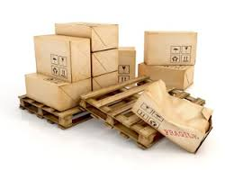
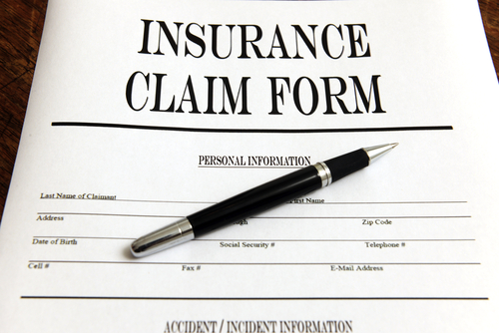
Risk Transfer
Risk transfer could be achieved by:
contractual agreement
insurance coverage/indemnity provisions
Example: Freight companies normally transfer the risk of goods getting damaged during the delivery by insuring the goods
Impact
Probability

Slide 15
Contractual Variations
Fixed Price (Lump Sum) – work for a fixed price; risk is transfer to the contractor
Cost Plus (remuneration) – costs PLUS a percentage of profit; allows for design changes
Payment Retention – the client retains a percentage of the payment to the contractor to counter against failure to comply with the contract; held till end of project
Design and Build (DB) – client has little input but little risk
PPP (public-private-partnership) – BOT, BOOT, BOO, BLT, DBFO, DBOT, DCMF, etc.
Notes:
BOT: Build–operate–transfer; BOOT: build–own–operate–transfer; BOO: build–own–operate; BLT: build–lease–transfer; DBFO: design–build–finance–operate; DBOT: design–build–operate–transfer; DCMF: design–construct–manage–finance

